Slide 1

Welcome to the
University Fellowship of Christians
#citywide
Twittter: @ufc_utas
Instagram: @uni_fellowship
Notes:
<number>
<number>

Slide 2
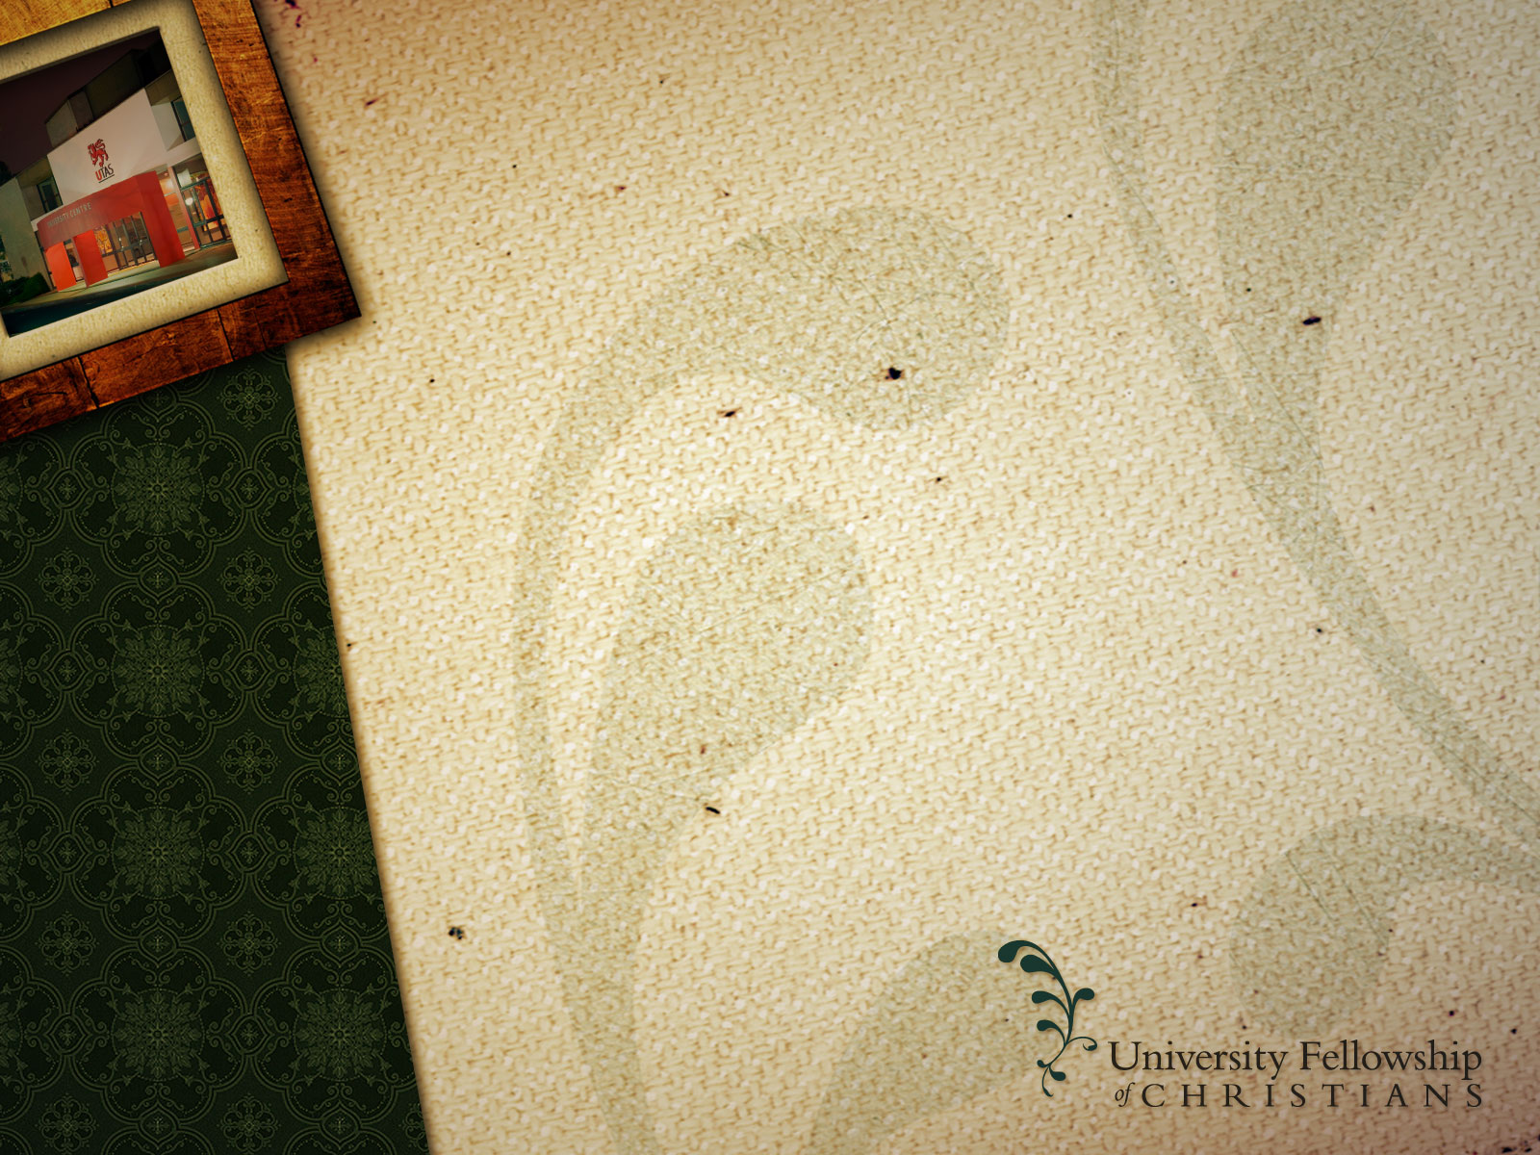
Citywide Gatherings
Semester 2 2017
TONIGHT: The Crusades
28th September: Colonialism and Missionaries
26th October: The Reformation
Notes:
<number>
<number>

Slide 3
The Breakfast Sessions
Semester 2 2017
12th September: The Miserable Puritans
26th September: The Death of God
Notes:
<number>
<number>

Slide 4


Slide 5


Slide 6


Slide 7


Slide 8


Slide 9
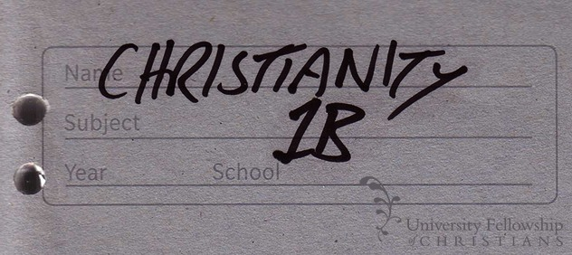

Slide 10


Slide 11


